Slide 1
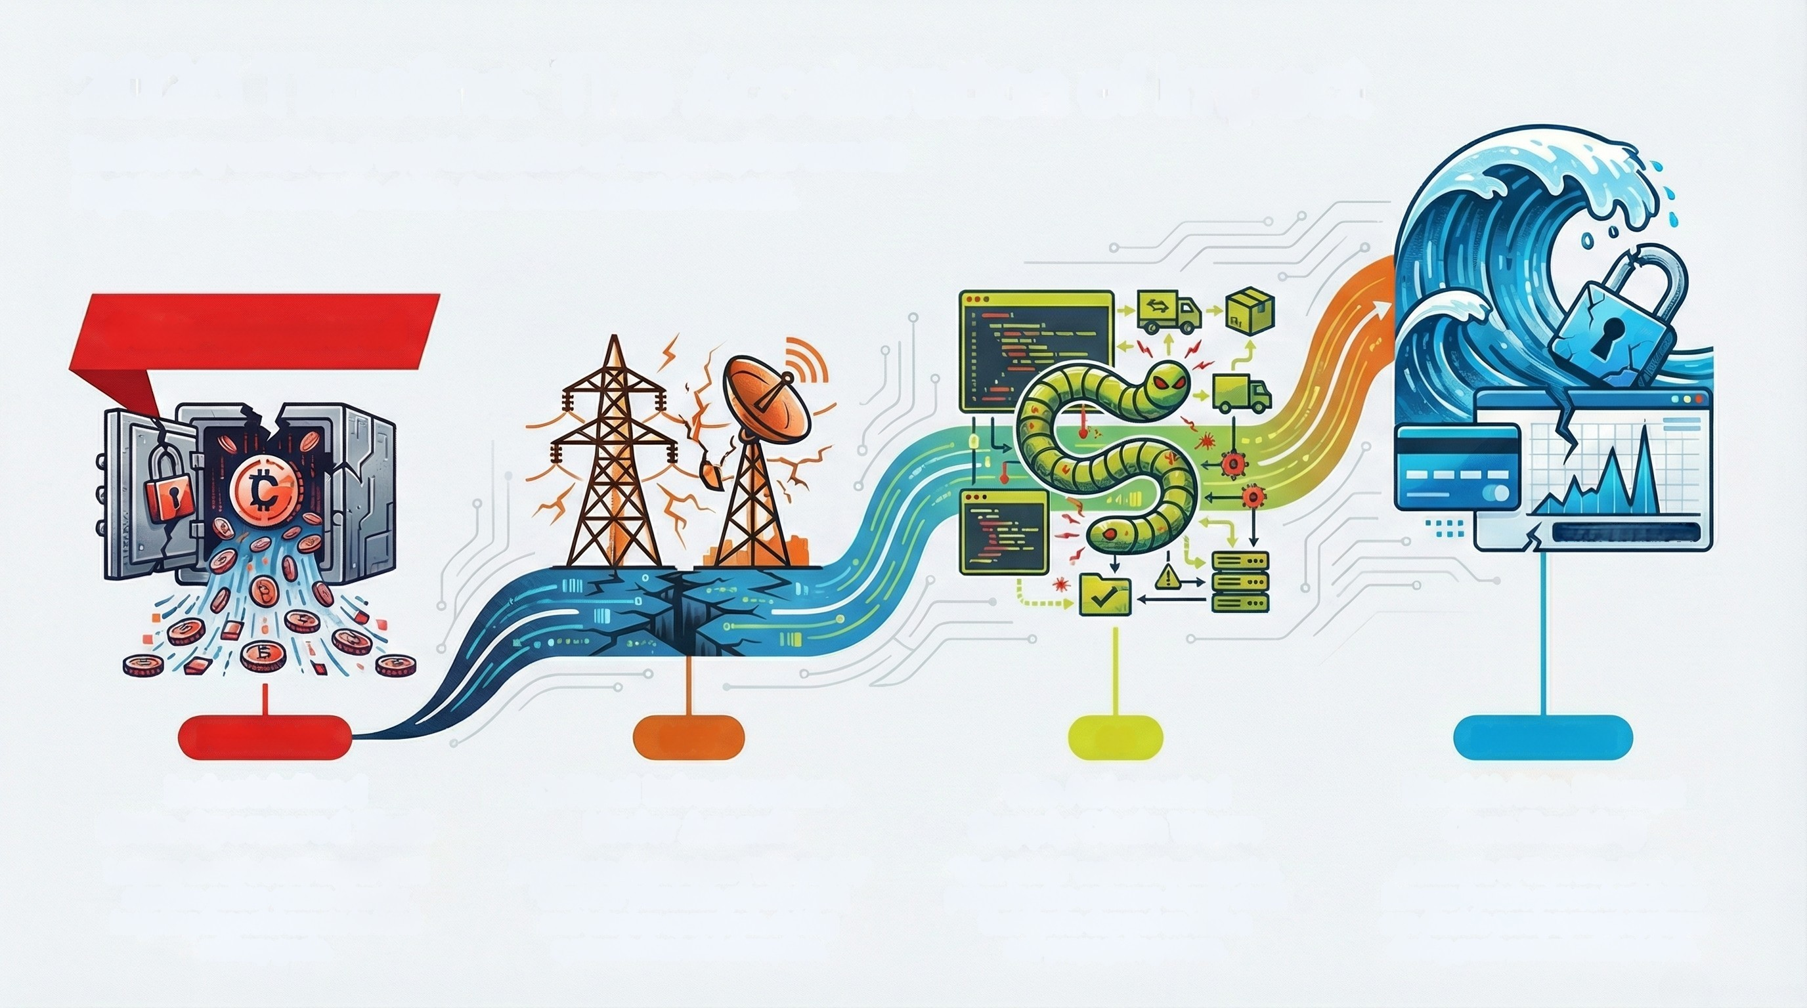
2025 Timeline: The Acceleration of Impact
Escalating scale and sophistication of major cyber events
highlighting strategic risks for the financial sector.
State-Sponsored
SERVICE UNAVAILABLE
FEBRUARY
MAY
Q3
DECEMBER
Industrialized
State-Sponsored Theft
Lazarus Group's $1.5B crypto theft
signifies nation-states directly
targeting financial assets to fund
military goals.
Critical Infrastructure
Under Assault
Coordinated campaigns ("NightSpire,"
"DireWolf") threaten physical grid
and telecom operations, risking
systemic financial disruption.
The Automated
Supply Chain Worm
"Shai-Hulud" marks a tipping point,
poisoning the software supply chain
that banks depand on with a
self-propagating worm.
Hacktivists Disrupt
Core Banking
A massive 10 Tbps DDoS on La
Banque Postale proves hacktivists
can disable core payment systems
during peak commercial periods.

